Slide 1
The ML Landscape
Tim Smith, PhD

Slide 2
Agenda
What is machine learning?
Types of machine learning
Supervised, unsupervised, reinforcement learning
Machine learning essentials
Data set
Data partitioning
Model assessment
Underfitting/overfitting
Examples of Modeling

Slide 3
What is Machine Learning (ML)
Science (and art) of programming (making) computers learn from (historical) data
“The field of study that gives the computer the ability to learn without being explicitly programmed” (Arthur Samuel, 1959)
(Process of finding patterns and rules in large data sets (and using these patterns and rules to make predictions)

Slide 4
Terminology
Value being predicted: Target, dependent, outcome, label, Y
Values used for prediction: Inputs, independents, predictors, features, dimensions, attributes, X
Two types of values:
Continuous, interval, numeric
Categorical, class
Nominal
Ordinal
Binary

Slide 5
Terminology
Regression task: predicted value is continuous (numeric)
Classification task: predicted value is categorical (binary or multi-class)

Slide 6
Supervised vs. Unsupervised Learning
 | Supervised Learning | Unsupervised Learning
Goal: | Predict a value (continuous or categorical) | Learn data representation
Target variable: | Yes | No
Data partition: | Yes | No
Data validation: | Yes | No
Example: | Linear regression Neural network Decision tree | Cluster analysis Autoencoder Anomaly detection

Slide 7
Challenges of ML
Irrelevant data
Insufficient data
Non-representative training data
Data quality (outliers, noise, missing values)
Underfitting
Overfitting

Slide 8
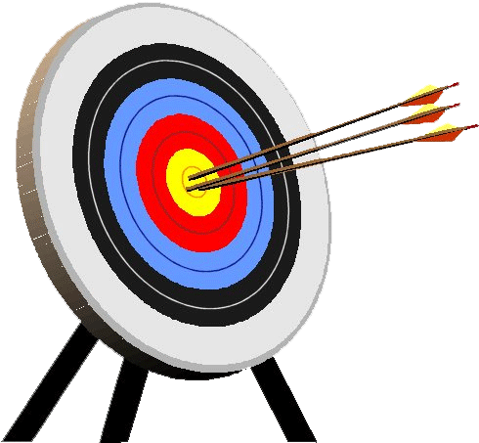
Predictive Modeling
Goal: build a representational model of a relationship between input and target values that predicts target measures that we have not yet seen.
Input
Hidden
Relationship
Target
Representational Model
Predicted
Target
The “hidden relationship” produces the target we are attempting to “hit”.
A representation model attempts to “hit” the target.

Slide 9
Context Setting… let’s begin with a quick review of the fundamentals

Slide 10
Data Labeling
Data Set
In predictive modeling we identify and label variables as inputs and targets.
NOTE: You may also hear similar terms such as Independent and Dependent variables,
Explanatory and Response variables.
Though there are subtle differences between these terms, today we will see these as essentially “meaning” the same thing
inputs
target
Each row in our table is an observation, also known as cases.

Slide 11
Identify a Predictive Model
Data Set
inputs
target
Our goal is to identify a “Good” model that associates the observed inputs to observed targets

Slide 12
Predictive Models “Predict” Target values
Data Set
inputs
predictions
A predictive model, when given a set of input measurements, produces “predictions” of what the target value will be

Slide 13
The Predictive Modeling Process
Involves “training” a model to learn the best fit for the given data
Data Set
inputs
target
predictions
Guided by known values of our target variable, a number of candidate models are tested and “fine tuned”.

Slide 14
The Predictive Modeling Process
“training” a model to learn the best fit for the given data
Data Set
inputs
target
predictions
errors
+
Model Selection &
Refinement
Prediction
Better models have smaller error signals. The “best model” has the lowest error signal.
This error signal can get small, but rarely goes to zero.
The selection of models is bounded by skill, knowledge, capacity, and time
Supervised Learning Process
Model Testing
Error Signal

Slide 15
Assessing model “fit”…
In general, we have two key approaches to assessing model fit:
Model fit measures: Represent the error between the predicted values and the target values (i.e. sum of squared errors, r², misclassification rate, etc.) without assuming too much about the population
Confidence: Conduct a statistical test to identify how confident you are that the model fits the target population and is not the result of chance (based on assumptions about the population).
errors
The smaller the error the better the fit to the given data

Slide 16
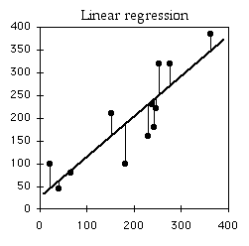
An Example of assessing model fit…
One example that many of you will be familiar with is a (Least Squares) Regression Model
Given a set of data – with one continuous input variable, and one continuous output variable, we may then visually determine that the “best” model is the linear model – and we then attempt to fine tune the fit of this model by adjusting m and b (slope and intercept from y=mx+b ) to best fit (least error) the predicted values to the observed values
Take inputs and use
a linear model to predict target values…
inputs
target
predictions
Difference between
Predicted and Observed Target values are Errors
errors
The smaller the error the better the fit to the given data
Using Regression, we
develop a prediction
model …
Prediction=β₀+β₁(input)
(simply another form of y=mx+b)

Slide 17
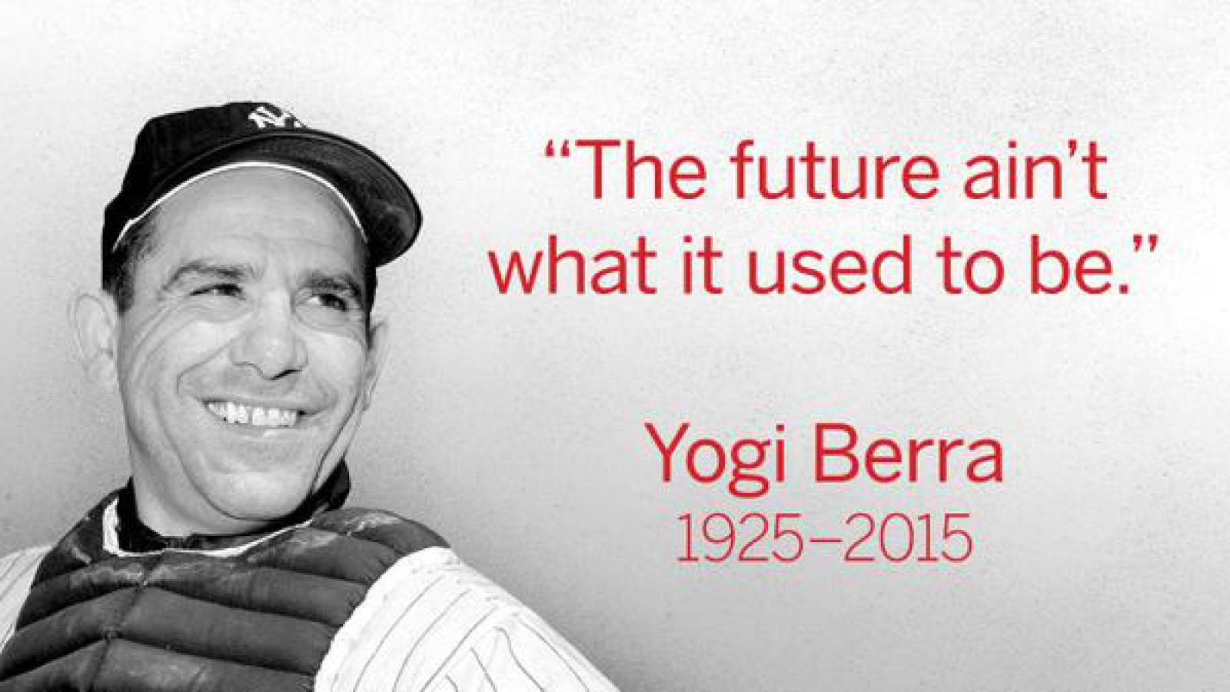
Now, let’s focus on two important issues in predictive analytics that set it apart from descriptive analytics…

Slide 18
Let’s ‘try’ to predict the future …
For demonstration purposes, I’ve created a data generating stochastic process. There is a pattern within this data that is hidden from us. Let’s to identify this pattern.

Slide 19
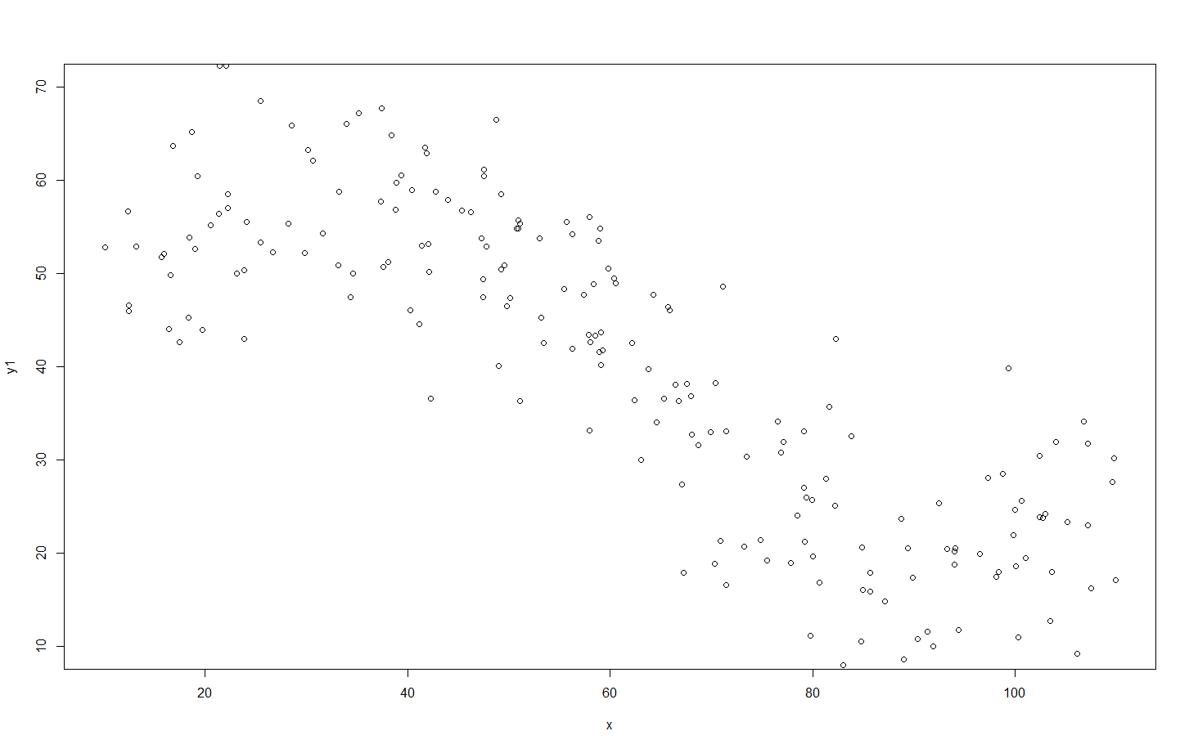
Using this process, I generate 200 observations…

Slide 20
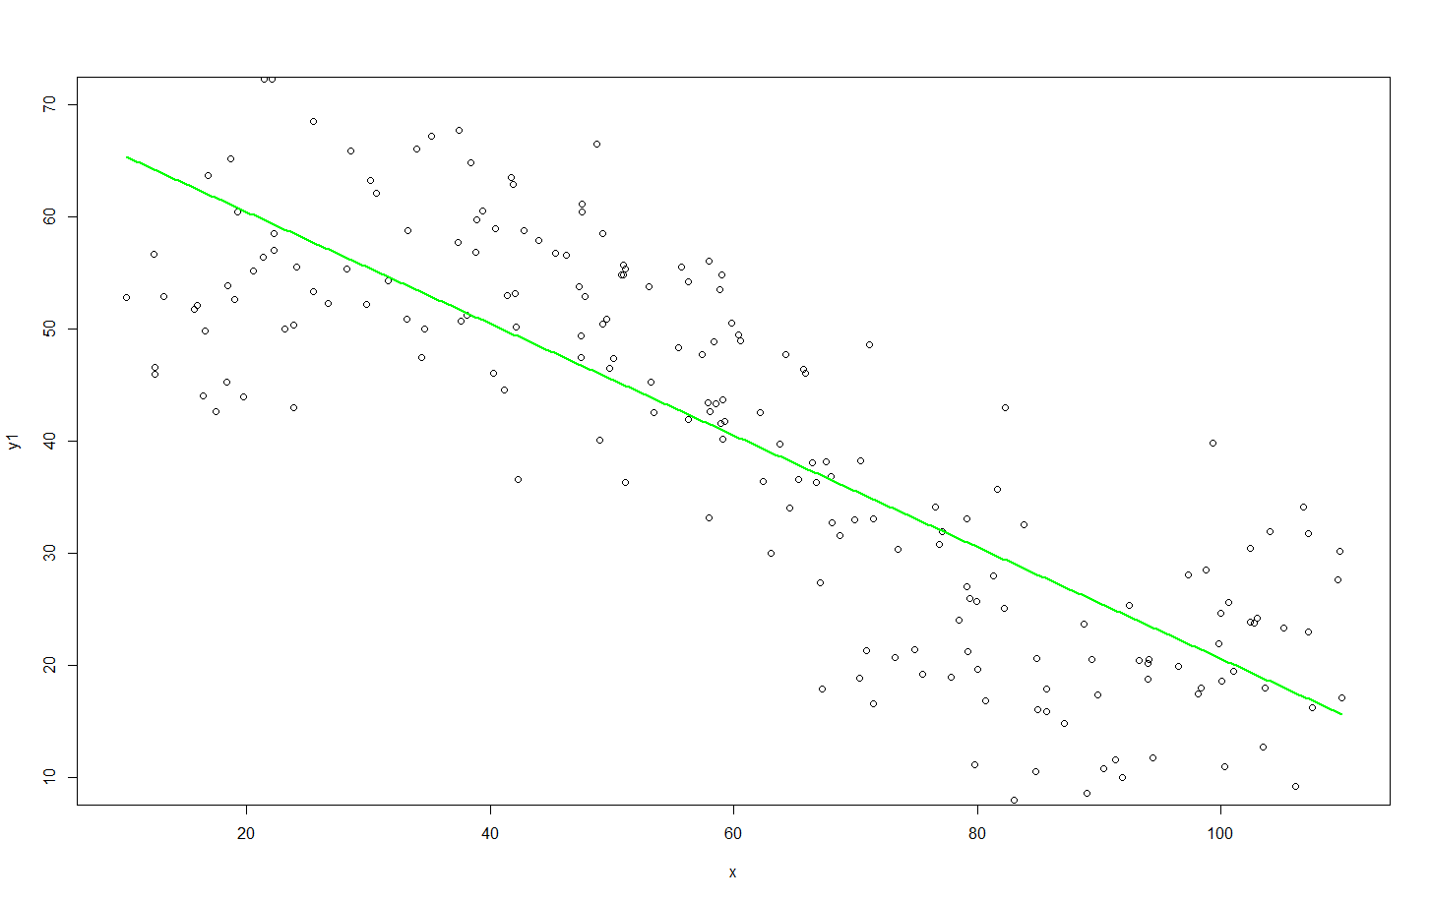
I fit my 1st Candidate Model to this “training” data:
Y=β₀+β₁x
Y=70.3-0.51x
Root Mean Squared Error = 10.71

Slide 21
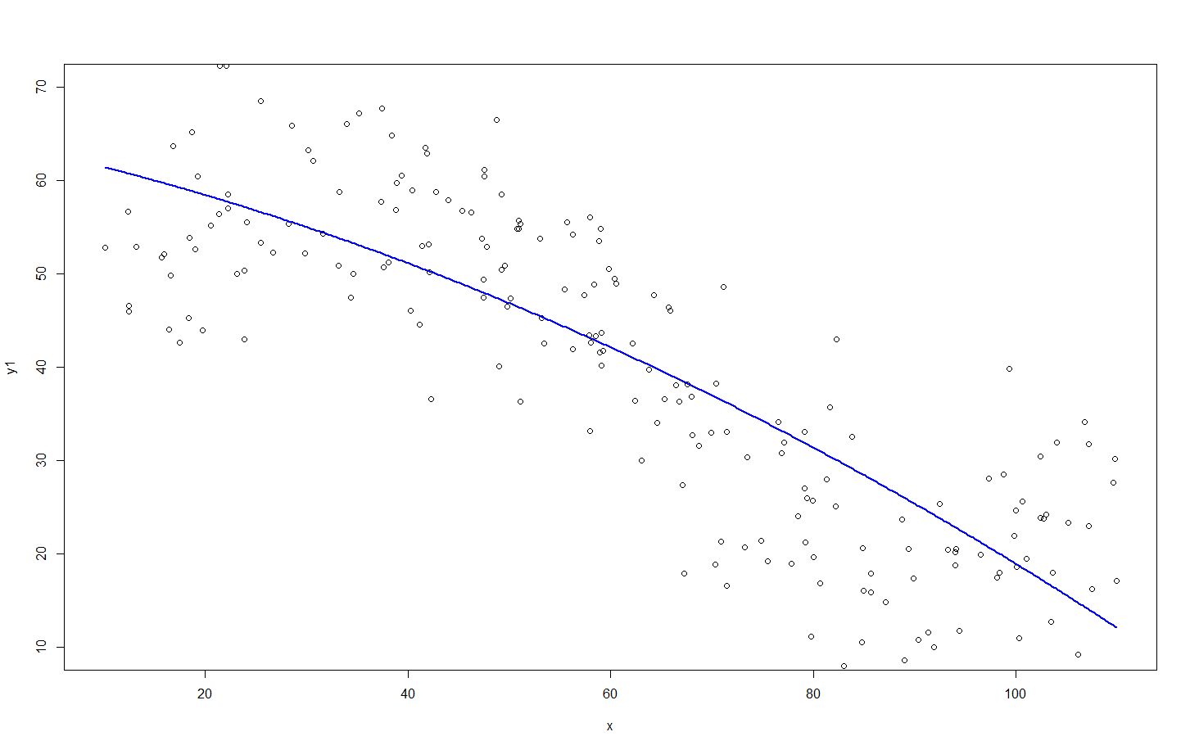
…Then, my 2nd Candidate Model:
Y=β₀+β₁x + β₂x²
Y=63.8-0.22x-0.002x²
Root Mean Squared Error = 9.94

Slide 22
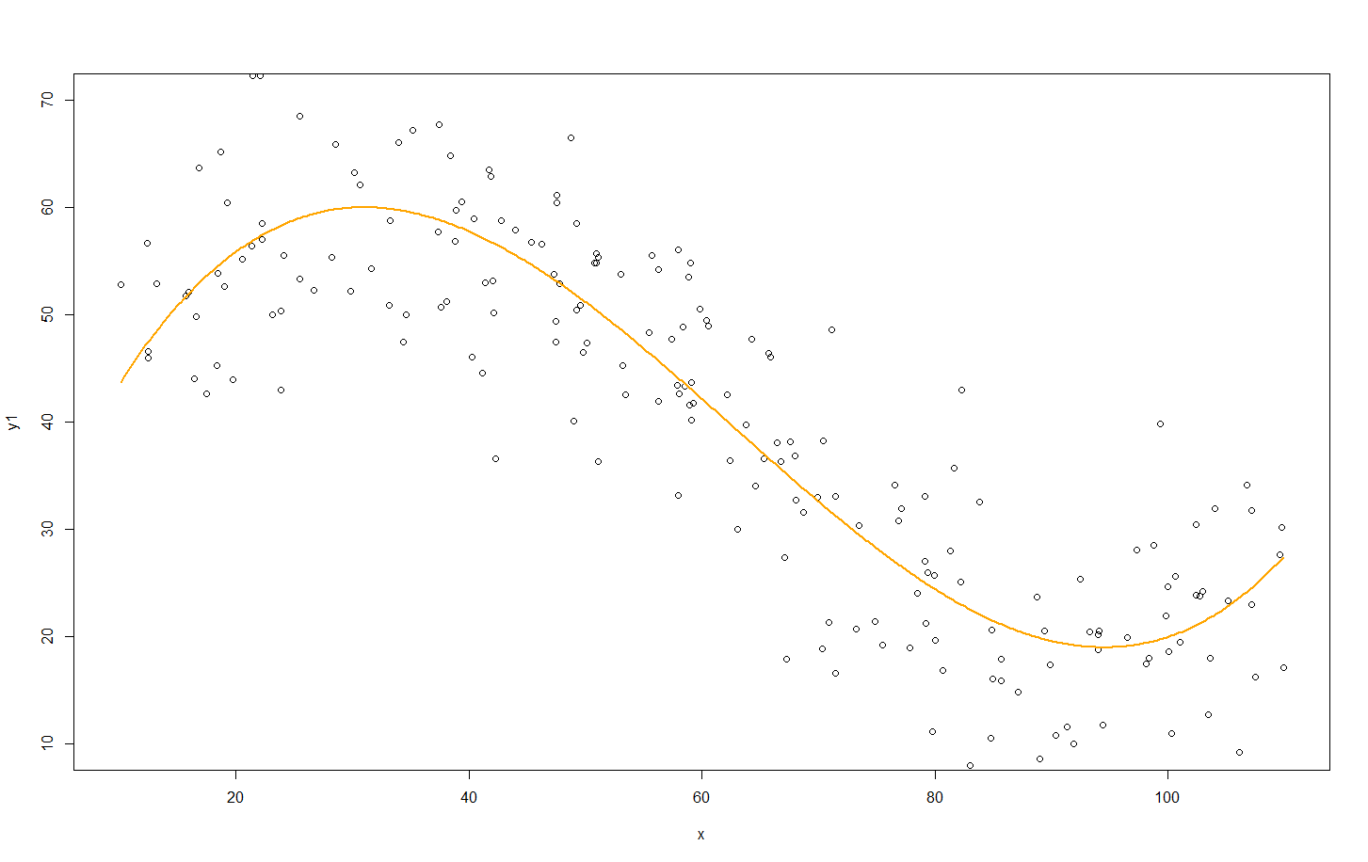
3rd Candidate Model:
Y=β₀+β₁x +β₂x²+β₃x³
Y=24.4+3.66x-0.058x²+0.0003x³
Root Mean Squared Error = 7.64

Slide 23
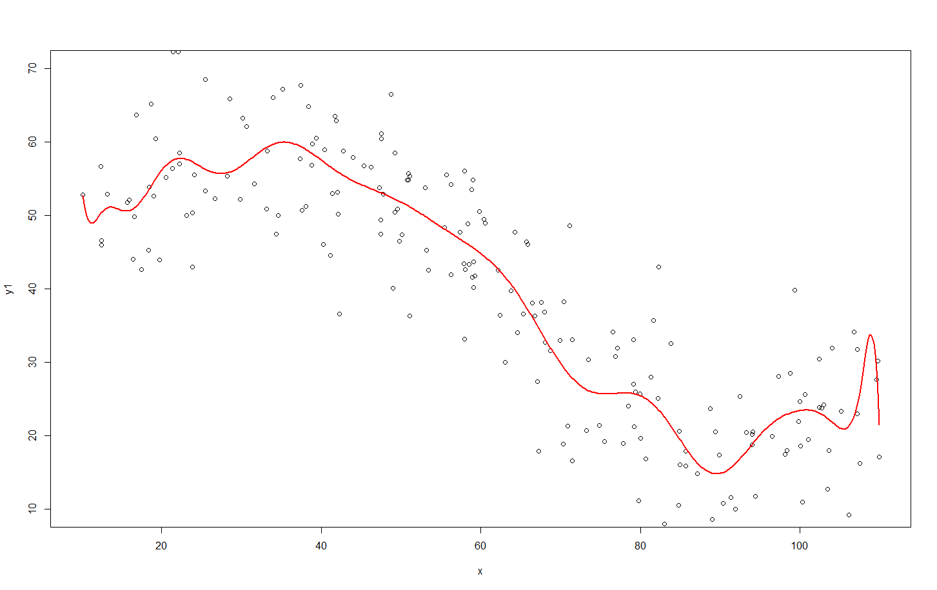
4th Candidate Model:
Y=β₀+β₁x +β₂x²+β₃x³+ β₄x⁴+β₅x⁵+ β₆x⁶+β₇x⁷+ β₈x⁸+β₉x⁹+ β₁₀x¹⁰+β₁₁x¹¹+ β₁₂x¹²+β₁₃x¹³+ β₁₄x¹⁴+β₁₅x¹⁵+ β₁₆x¹⁶+β₁₇x¹⁷+ β₁₈x¹⁸+β₁₉x¹⁹+ β₂₀x²⁰
Y=11490-4490.9x +777.3x²-78.1x³+ 5.1x⁴-0.29x⁵+ 0.007x⁶-0.00017x⁷+ 2.7*10⁻⁶x⁸-3.12*10⁻⁸x⁹+ … -1.97*10⁻²⁴x²⁰
Root Mean Squared Error = 7.38

Slide 24
The “Best” Performing Model??
Set of Predictive Models | Model Fit on Training Data (Root Mean Square Errors)
#1) Y=β₀+β₁x | 10.71
#2) Y=β₀+β₁x β₂x² | 9.94
#3) Y=β₀+β₁x +β₂x²+β₃x³ | 7.64
#4) Y=β₀+β₁x +β₂x²+β₃x³+ β₄x⁴+β₅x⁵+ β₆x⁶+β₇x⁷+ β₈x⁸+β₉x⁹+ β₁₀x¹⁰+β₁₁x¹¹+ β₁₂x¹²+β₁₃x¹³+ β₁₄x¹⁴+β₁₅x¹⁵+ β₁₆x¹⁶+β₁₇x¹⁷+ β₁₈x¹⁸+β₁₉x¹⁹+ β₂₀x²⁰ | 7.38

Slide 25
Is a that last model (the 20th order polynomial) the better predictive model? To answer this, we need to understand how to systematically balance between complexity, and guarding against under/over fitting

Slide 26
The “Best” Performing Model…
Using the four models that “I fitted” to the training data, I test the fit of each model on a new batch of data (produced by the same stochastic process that I used to generate the first batch), we’ll call this new data the validation data…
Set of Predictive Models | Model Fit on Training Data (Sum of Squared Errors) | Model Fit on Test Data (Sum of Squared Errors)
#1) Y=β₀+β₁x | 10.71 | 10.31
#2) Y=β₀+β₁x β₂x² | 9.94 | 10.21
#3) Y=β₀+β₁x +β₂x²+β₃x³ | 7.64 | 8.99
#4) Y=β₀+β₁x +β₂x²+β₃x³+ β₄x⁴+β₅x⁵+ β₆x⁶+β₇x⁷+ β₈x⁸+β₉x⁹+ β₁₀x¹⁰+β₁₁x¹¹+ β₁₂x¹²+β₁₃x¹³+ β₁₄x¹⁴+β₁₅x¹⁵+ β₁₆x¹⁶+β₁₇x¹⁷+ β₁₈x¹⁸+β₁₉x¹⁹+ β₂₀x²⁰ | 7.38 | 9.19
NOTICE: Notice that I’m only using training and validation data. This is quite common and approach. Therefore, it can be confusing on when we should use a test. This “depends” on our goals, and the size and quality of your dataset.

Slide 27
The “Best” Performing Model…
Set of Predictive Models | Model Fit on Training Data (Sum of Squared Errors) | Model Fit on Test Data (Sum of Squared Errors)
#1) Y=β₀+β₁x | 10.71 | 10.31
#2) Y=β₀+β₁x β₂x² | 9.94 | 10.21
#3) Y=β₀+β₁x +β₂x²+β₃x³ | 7.64 | 8.99
#4) Y=β₀+β₁x +β₂x²+β₃x³+ β₄x⁴+β₅x⁵+ β₆x⁶+β₇x⁷+ β₈x⁸+β₉x⁹+ β₁₀x¹⁰+β₁₁x¹¹+ β₁₂x¹²+β₁₃x¹³+ β₁₄x¹⁴+β₁₅x¹⁵+ β₁₆x¹⁶+β₁₇x¹⁷+ β₁₈x¹⁸+β₁₉x¹⁹+ β₂₀x²⁰ | 7.38 | 9.19
Increasing
Complexity
Better fit
Worse fit
What’s going on here is that the most complicated model — in this case, the 20th order polynomial— is not fitting the generalizable features of the data. Instead, this model is fitting the sampling noise, or the accidents which don’t repeat.
In general overly complex models tend to over-fit the data. Conversely, models that are too simple may not describe the generalized features of the data with sufficient detail, and thus result in under-fitting.

Slide 28
Which is the better predictive model…
Set of Predictive Models | Model Fit on Training Data (Sum of Squared Errors) | Model Fit on Validation Data (Sum of Squared Errors)
#1) Y=β₀+β₁x | 10.71 | 10.31
#2) Y=β₀+β₁x β₂x² | 9.94 | 10.21
#3) Y=β₀+β₁x +β₂x²+β₃x³ | 7.64 | 8.99
#4) Y=β₀+β₁x +β₂x²+β₃x³+ β₄x⁴+β₅x⁵+ β₆x⁶+β₇x⁷+ β₈x⁸+β₉x⁹+ β₁₀x¹⁰+β₁₁x¹¹+ β₁₂x¹²+β₁₃x¹³+ β₁₄x¹⁴+β₁₅x¹⁵+ β₁₆x¹⁶+β₁₇x¹⁷+ β₁₈x¹⁸+β₁₉x¹⁹+ β₂₀x²⁰ | 7.38 | 9.19
✓
Though #4 best fit the data we used for training, it performed poorly on the validation (new) data. Therefore, the best predictive model seems to be #3, not #4.

Slide 29
…let’s elaborate on this data splitting

Slide 30
Data Splitting and “Right” Fitting Honest Testing of our Predictive Model
Validation
Training
Test

Slide 31
Addressing issues of fit and complexity
The training set is used to determine the best fitting parameters for each of our models.
The validation set allows us to test each model against new data and determine the best performing model.
The test set allows us to conduct an honest assessment (or scoring) of how well the selected model performs. Our goal is to verify if the accuracy is sufficient.
Application phase is the deployment and use of the model. If the performance of the model becomes unsatisfactory (especially is the population “drift”), revisit the model development process

Slide 32
Data Partitioning
Training Data
Original Data
inputs
target
inputs
target
Validation Data
inputs
target
Test Data
inputs
target
Three data sets (Training, Validation, and Test) are sampled from the original data sets.

Slide 33
Predictive Model Sequence
Training Data
Validation Data
inputs
target
inputs
target
1
2
Using the training data create a number of potential models – some of which more complex than others
3
4
5
Model
Complexity

Slide 34
Model Performance Assessment
Training Data
Validation Data
inputs
target
inputs
target
1
Rate model performance using validation data.
2
3
4
5
Model
Complexity
Validation
Assessment

Slide 35
Model Selection
Training Data
Validation Data
inputs
target
inputs
target
1
Select the simplest model with the highest validation assessment.
2
3
4
5
Model
Complexity
Validation
Assessment

Slide 36
“Honestly” Assessing Selected Model Performance
Training Data
Test Data
inputs
target
inputs
target
Rate the model’s performance on a test set of data… A set of data not used in the training of the model or to cross validate the model.
3

Slide 37
Underfitting vs. Overfitting
Avoid underfitting:
Change hyperparameters
Change algorithm
Feature engineering
Reduce model constraints (i.e., reduce regularization)
Avoid overfitting:
Change hyperparameters
Simplify the model
Reduce the number of epochs to train
Use model constraints (i.e., regularization)
Gather more data
Reduce noise in data

Slide 38
Models
“A system of postulates, data, and inferences presented as a mathematical description of an entity or state of affairs”¹
Which of the following could we consider a “model”
y = 2x + 3
Yes, given a value (we’ll label as x), we can determine another value (which we label as y).
Color is red if x is 1, otherwise color is blue
Yes, given a value (we’ll label as z), we can determine an associated color.

Slide 39
Predictive Models
Much of this course will be dedicated to looking at predictive models.
In predictive modeling we use various method to identify patterns from past data and from this develop models to help predict future outcomes.
Let’s look at an example…

Slide 40
Classification Modeling Example: Riding Lawn Mower Ownership
Income | Lot_Size | Ownership
60 | 18.4 | Owner
85.5 | 16.8 | Owner
64.8 | 21.6 | Owner
61.5 | 20.8 | Owner
87 | 23.6 | Owner
110.1 | 19.2 | Owner
108 | 17.6 | Owner
82.8 | 22.4 | Owner
69 | 20 | Owner
93 | 20.8 | Owner
51 | 22 | Owner
81 | 20 | Owner
75 | 19.6 | Nonowner
52.8 | 20.8 | Nonowner
64.8 | 17.2 | Nonowner
43.2 | 20.4 | Nonowner
84 | 17.6 | Nonowner
49.2 | 17.6 | Nonowner
59.4 | 16 | Nonowner
66 | 18.4 | Nonowner
47.4 | 16.4 | Nonowner
33 | 18.8 | Nonowner
51 | 14 | Nonowner
63 | 14.8 | Nonowner
Classification Modeling Example:
Riding Lawn Mower Ownership

Slide 41
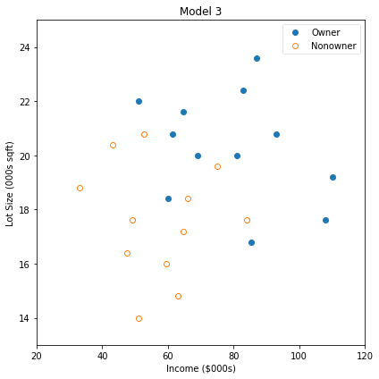
Our data

Slide 42
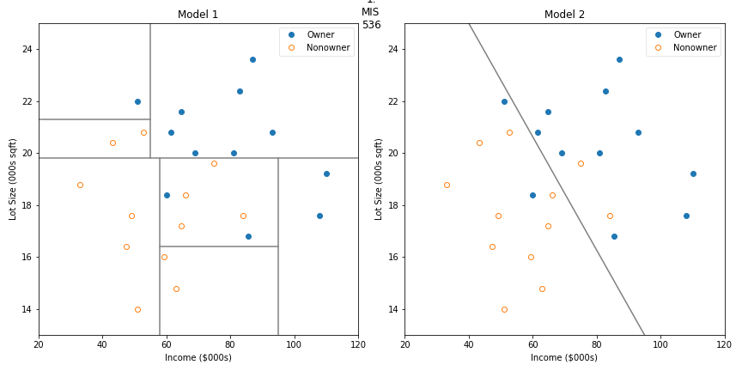
Classification Models

Slide 43
Classification Models

Slide 44
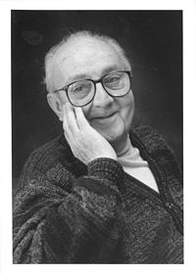
Models: The map, not the territory
“All models are wrong, but some are useful”
When we apply models to predict something in the “real world”, all models will have some level of error.
Errors in measurement
Errors in Data
Unmeasured/accounted for influences
Randomness
Dr. George Box
(18 October 1919 – 28 March 2013)

Slide 45
Data Camp
Accept invitation and create account using USF email
To verify you have successfully created your account, take the Understanding and Interpreting Data assessment
…your performance on this is not graded – completing it results in full marks)

Slide 46
Anaconda and Jupyter Lab
Download and install Anaconda
Run Jupyter Lab
Follow along with professor

